Slide 1
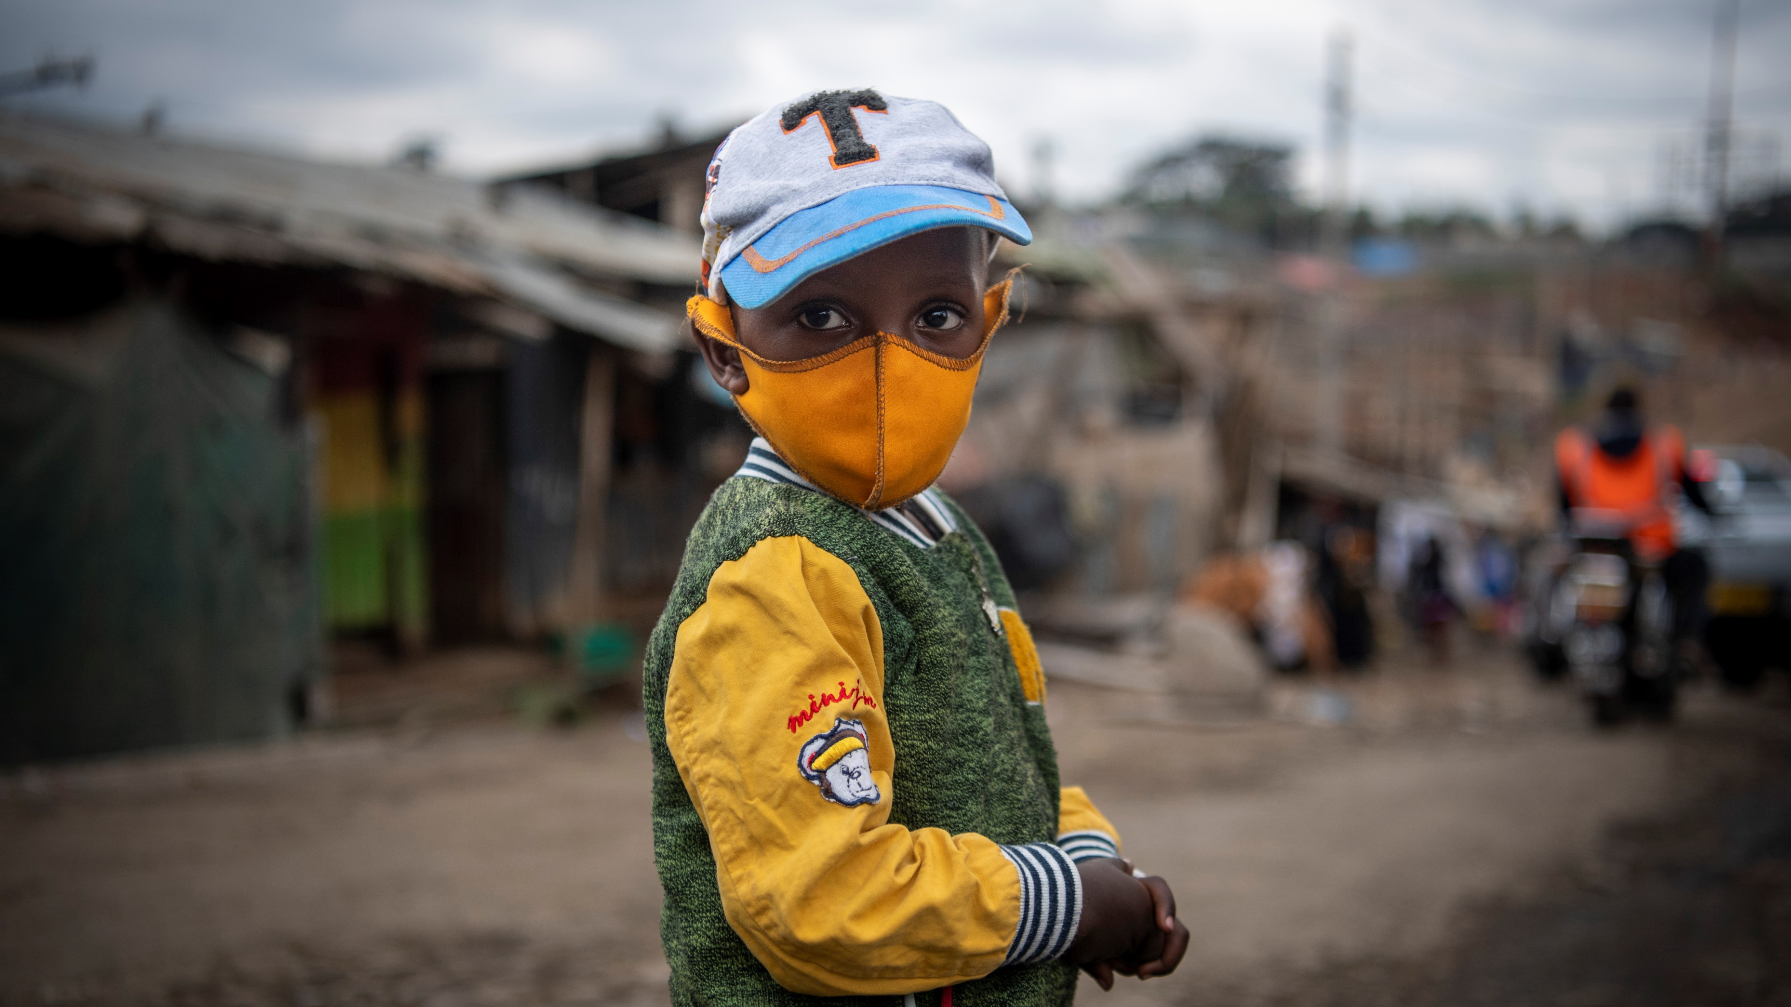

Mobile Phone-based Community Rapid Assessment on COVID-19: Early Findings on Behavioral Drivers, Community Coping Mechanisms and Communication Channels in Kenya​
UNICEF HQ: Evaluation Office & C4D Division UNICEF ESARO: Evaluation & C4D sections UNICEF Kenya Country Office October 8, 2020
© UNICEF/PHOTO CREDIT

Slide 2
Webinar Outline:
Community Rapid Assessment on COVID-19
Concept
Study Framework
ESAR Participating Countries and Disease Context
Methodology
Analytical Approaches
Main Questions
Early Findings
Demographics
Kenya, Madagascar & South Sudan Country Program Implications
Early Lessons Learned
Strengths and Limitations
2 | Community Rapid Assessment on COVID: 3 Countries in ESAR

Slide 3
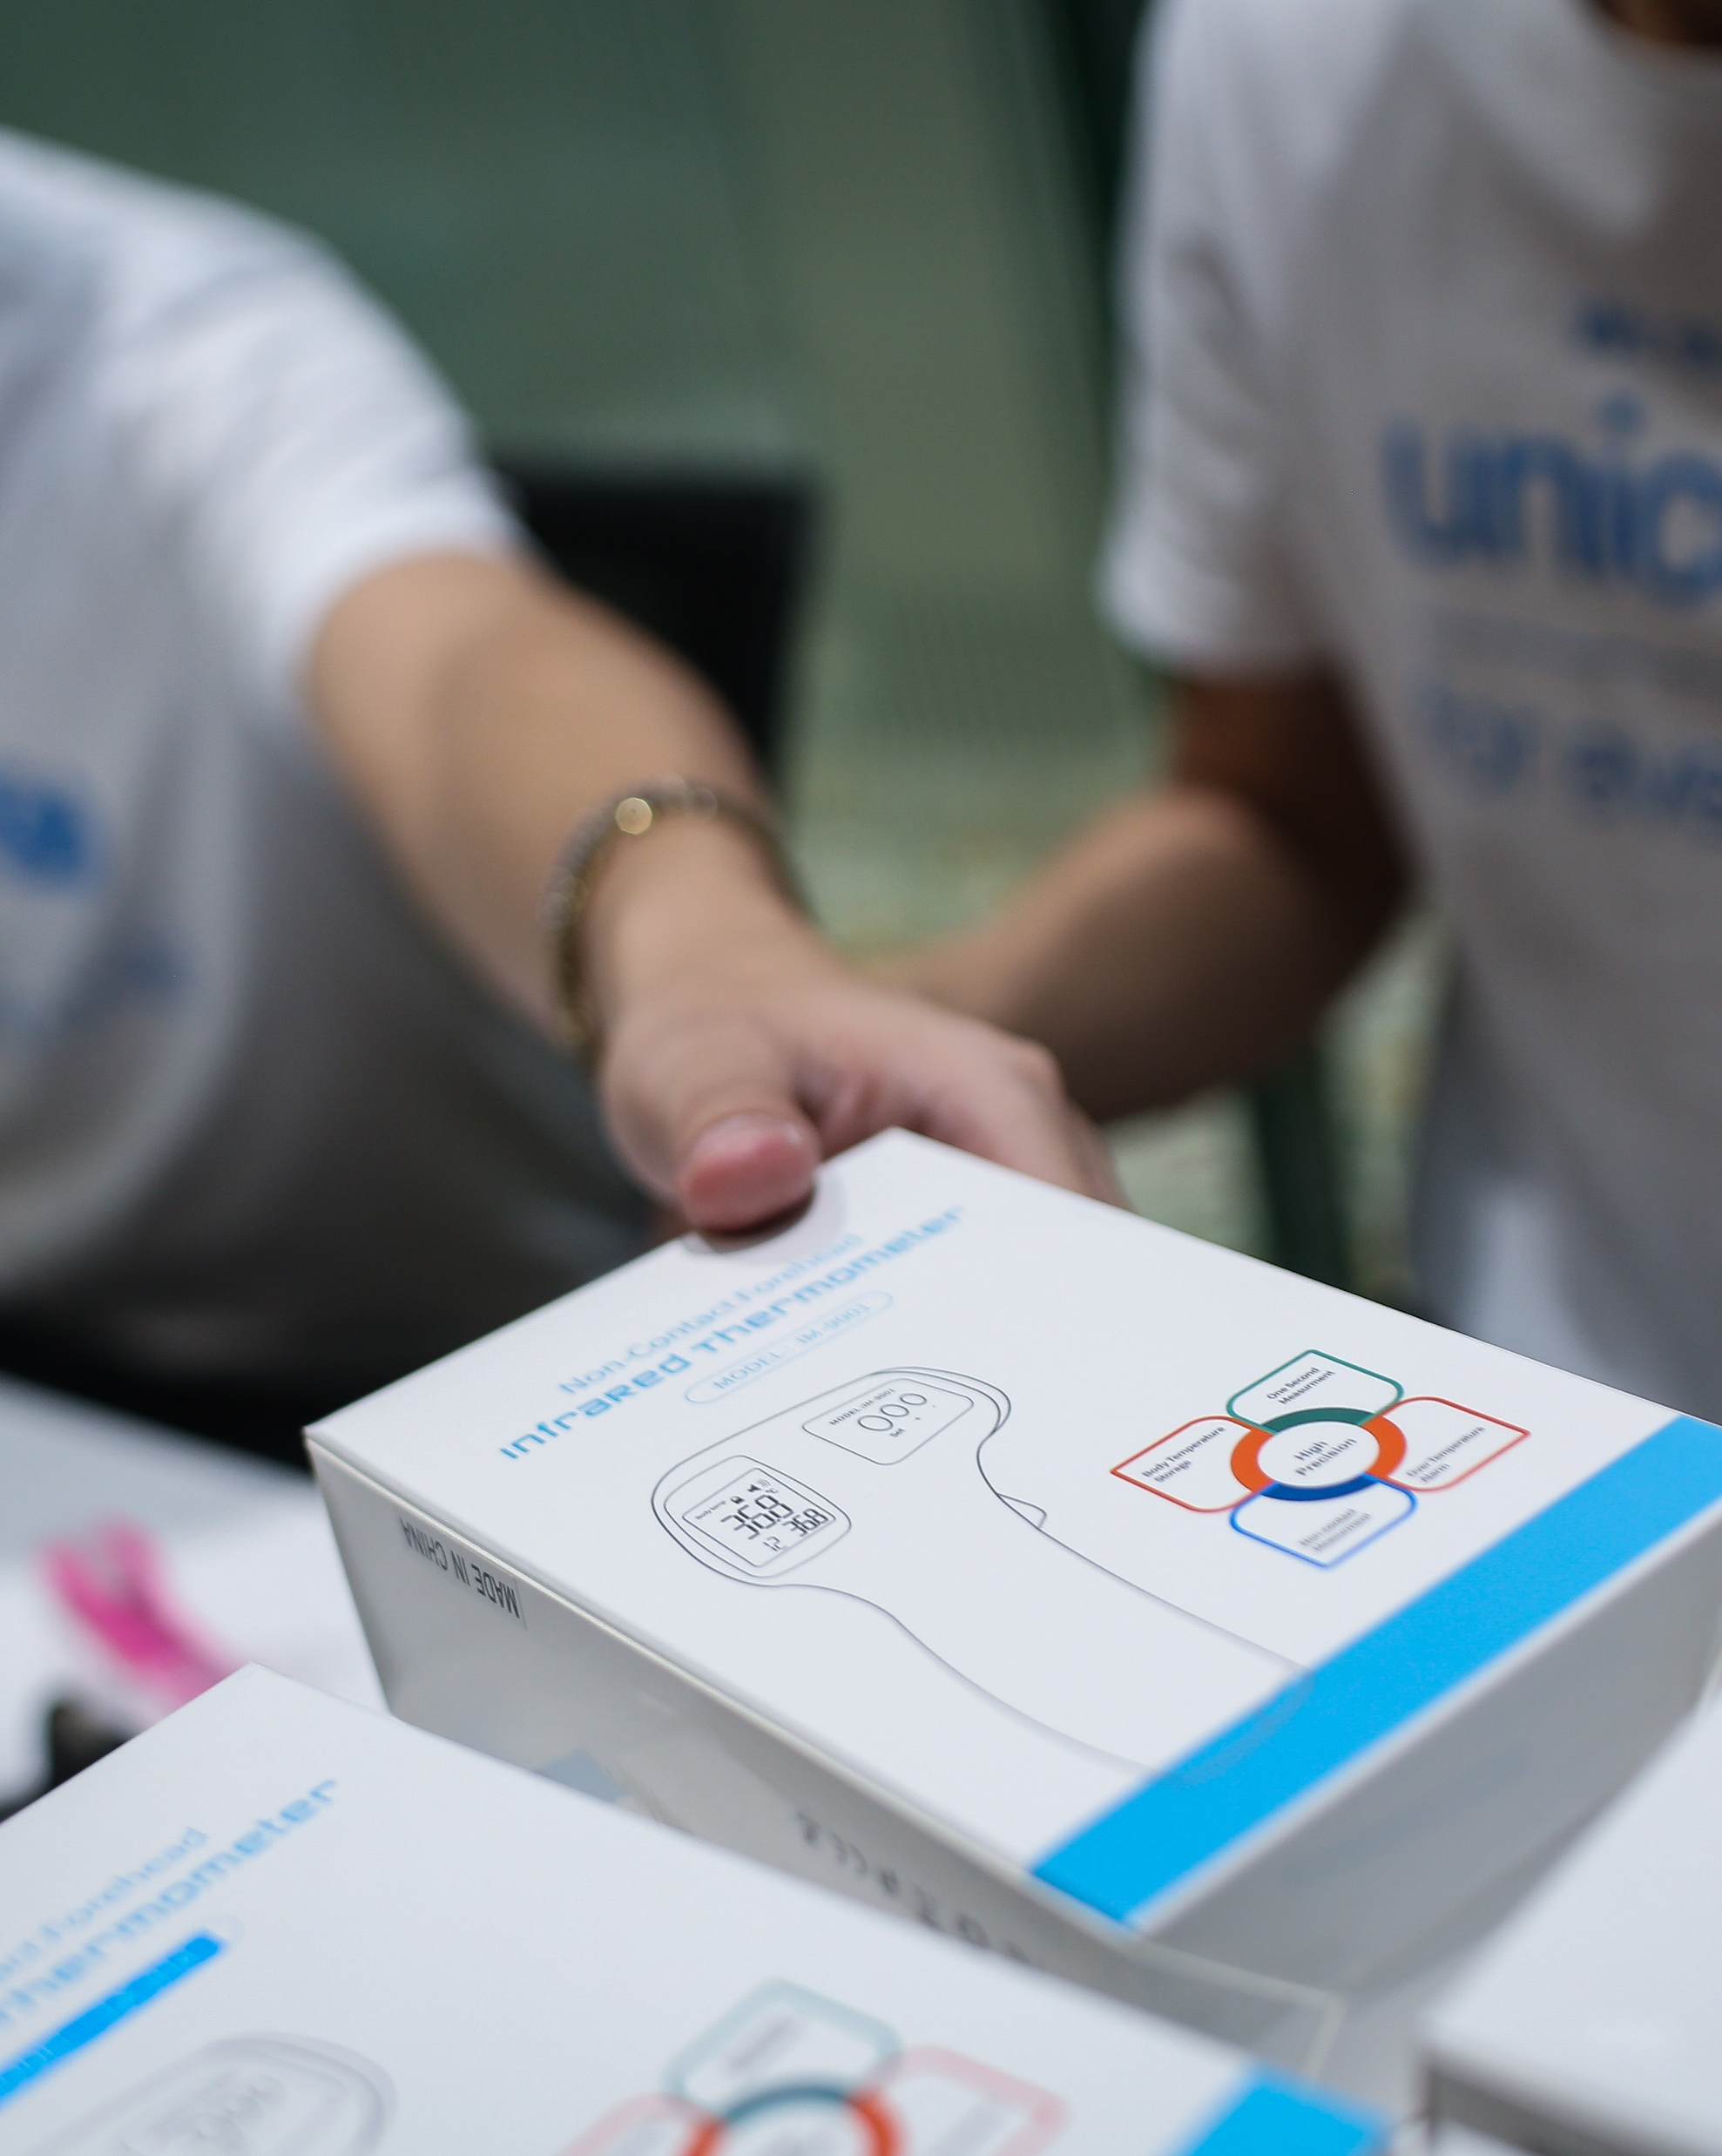
1. PROOF OF CONCEPT
A Rapid mobile-based population short survey on behavior, coping strategies and communication channels during COVID-19.
To examine behaviors and drivers using mobile phone-based population surveys in a time series in order to assess relevance and to better prepare UNICEF to address future pandemics.
To demonstrate a lightweight methodological approach that can be used in other sectors with a relatively small budget envelope.
To routinely use social and behavioral population surveys as part of a data source in understanding the organizations effectiveness, relevance, etc., in evaluation designs.
© UNICEF/PHOTO CREDIT
Find Concept Note here
3 | Community Rapid Assessment on COVID: 3 Countries in ESAR

Slide 4
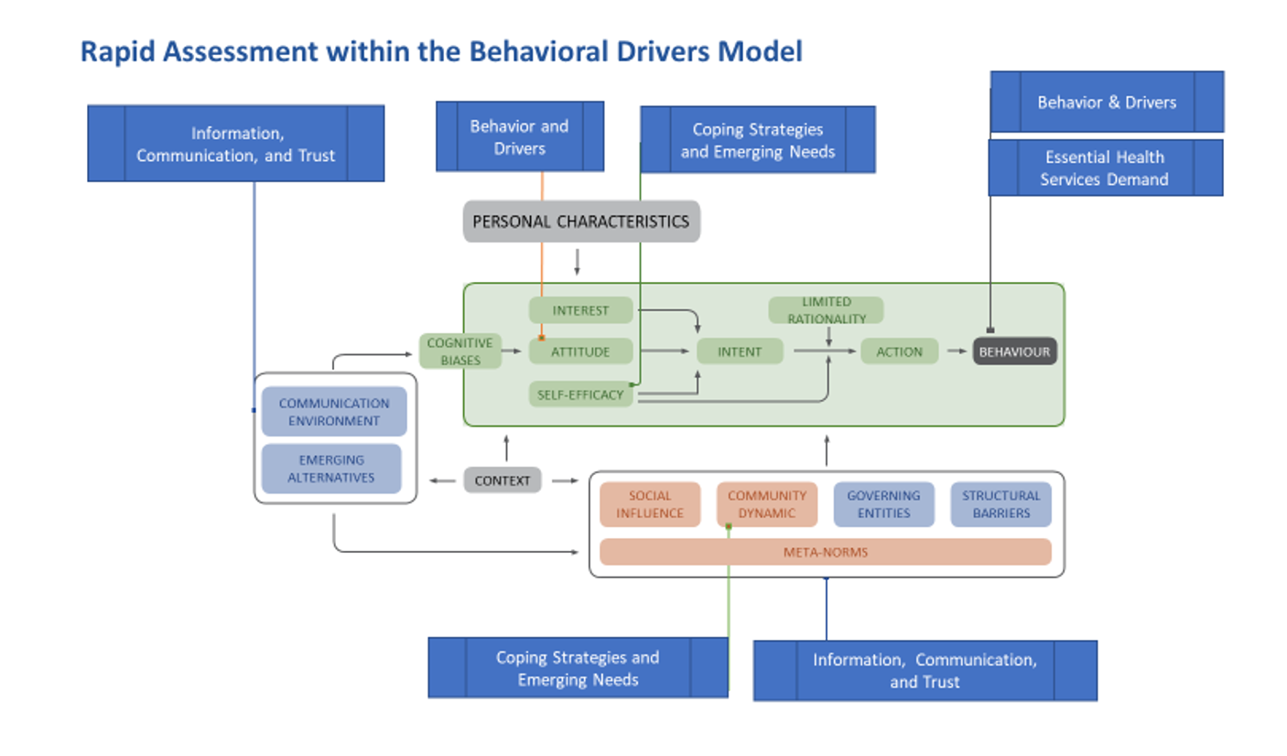
2. STUDY FRAMEWORK
To use population mobile-phone based surveying methods to examine behavioral changes, coping strategies, and evolving needs during the COVID-19 pandemic to inform programming and public policy efforts.
Find BDM framework here
4 | CRA ESARO: Early Findings
4 | Community Rapid Assessment on COVID: 3 Countries in ESAR
Notes:
On the CRA approach, you can add that it has been flexible in ESAR with trying to accommodate countries specific questions in questionnaire and also it integrated with existing KAp sudies in Madagascar and South Sudan

Slide 5
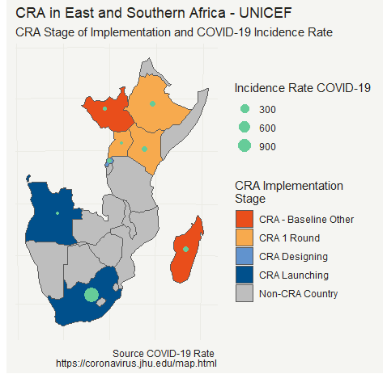
3. ESAR Participating Countries and ​
Disease Landscape
Current Participating Countries:
ANGOLA: Contracting in process
ETHIOPIA: Baseline Round 1 data collection completed; Analysis in process
KENYA: Baseline Round 1 completed & analyzed
MADAGASCAR: Baseline Round 1 completed and analyzed
RWANDA: Contracted completing, awaiting IRB approval
SOUTH AFRICA: Contracting in process
SOUTH SUDAN: Baseline Round 1 completed and analyzed
UGANDA: Round 1 data collection in progress
5 | Community Rapid Assessment on COVID: 3 Countries in ESAR
Notes:
https://covid19.who.int/table
https://africacdc.org/covid-19/

Slide 6

4. METHODOLOGY
Data Collection Modalities
Data Type: Quantitative, repeated cross-sectional time series.
Periodicity: Multiple rounds planned for 1-2 month
Geographic Coverage: National and sub-national
Sampling & Sample Size: Probabilistic; ~N=1,000
Instrument: Short quantitative survey with standardized questions with room for country adaptation (Max 24 questions)
Demographic variables:
a) Sex,
b) Age,
c) Education, and
d) Urban/Rural Setting
Random Digital Dialing using Interactive Voice Recording Survey
Face to Face (ONA platform, S. Sudan)
Quality Control
Pre-survey testing
Methodological review of instruments
Ex-Post facto sample weighting**
Country-Level Summary
Country | Survey Size | Modality | CRA Type
Kenya | n = 1124 | IVR | National CRA Standard
Madagascar | n = 4282 | Paper-based | National and Localized Baseline with CRA 2nd and 3rd Round
South Sudan | n = 1841 | ONA | Localized Baseline with CRA 2nd and 3rd Round
Find CRA ESARO Model questionnaire here

Slide 7
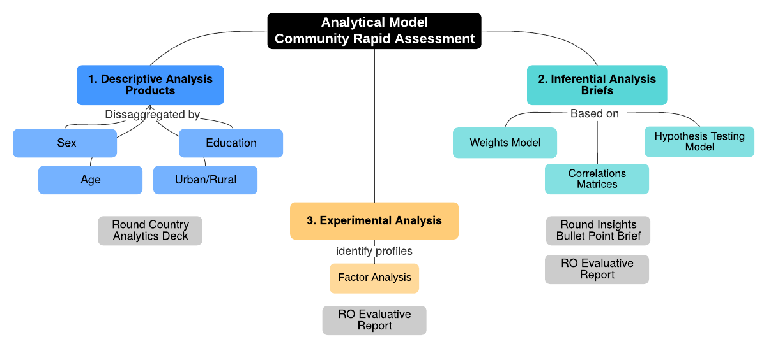
5. ANALYTICAL APPROACH
Principles:
Rapid deployment
Key insights focus on behaviors and drivers
Rigorous but flexible approach (including exploratory and non-parametric approaches)
For this review, we will:
Focus on key variables and look at comparisons across countries and groups
Highlight insights for program application
Find CRA Analytic Plan here
7 Community Rapid Assessment on COVID: 3 Countries in ESAR

Slide 8
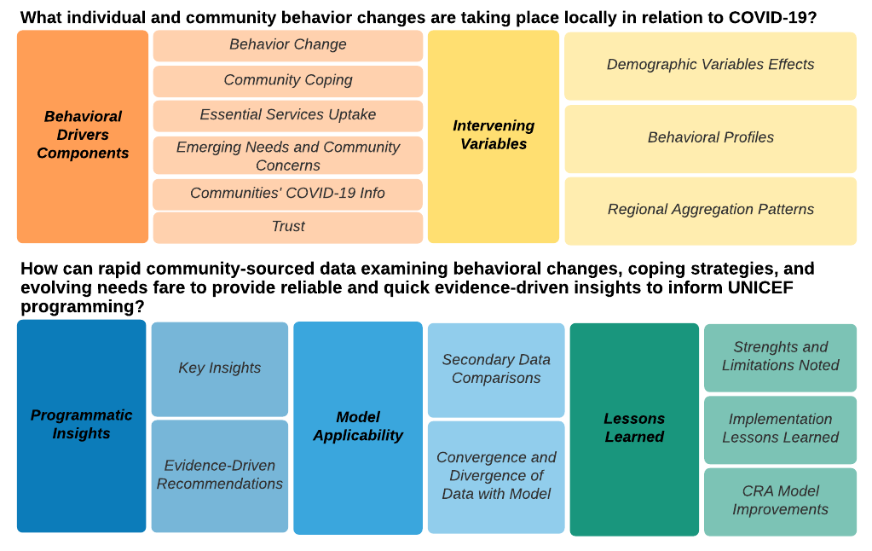
6. MAIN QUESTIONS
For these early results, we will:
Review selected key findings
Compare across countries, where possible
Highlight insights and areas for further analyses
8 | Community Rapid Assessment on COVID: 3 Countries in ESAR

Slide 9
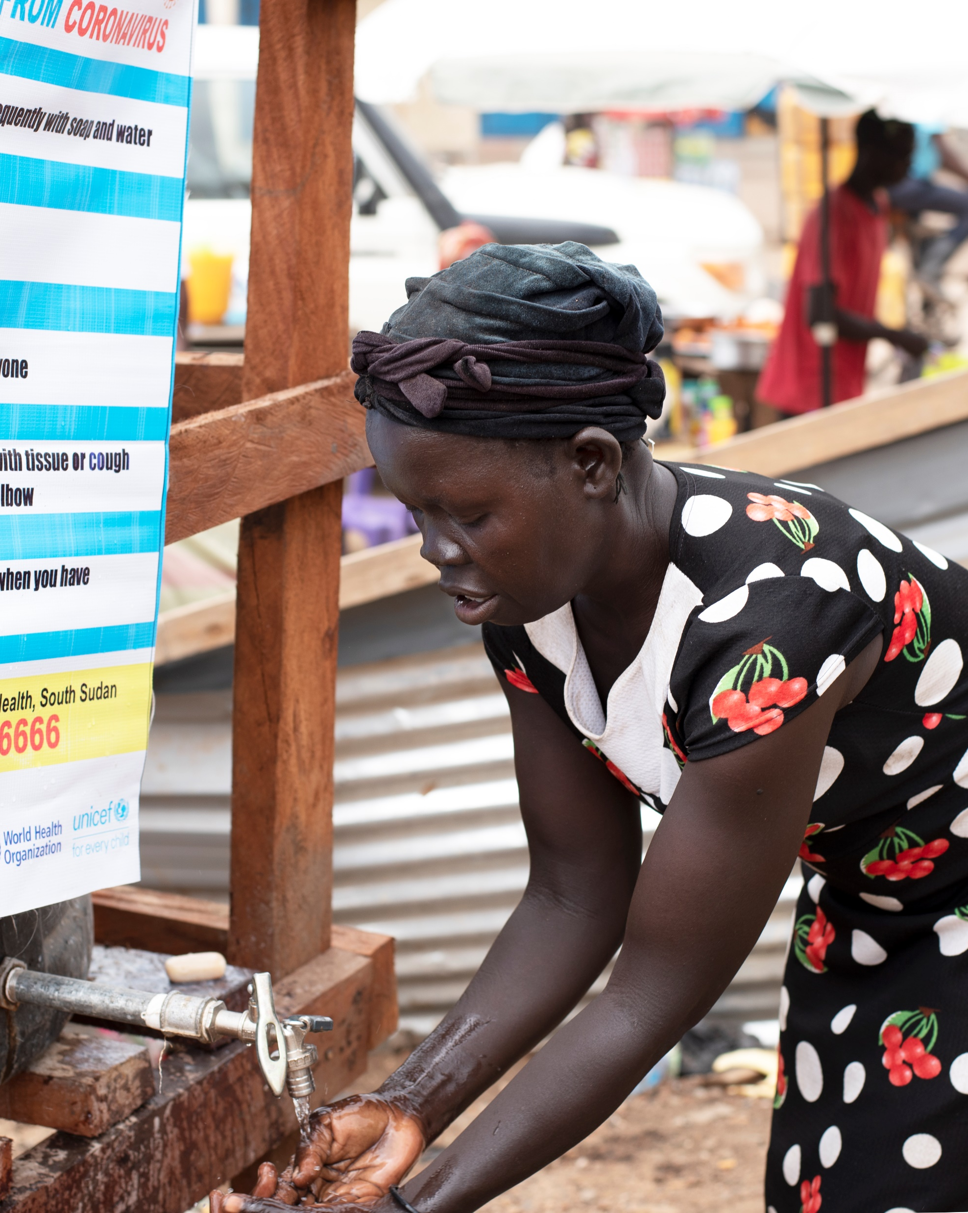
7. SELECTED EARLY FINDINGS:
What are the current behavioral practices taking place in relation to COVID-19?
Note: The following findings are of descriptive nature and are unweighted. However, they convey an early view of some key areas trends and distributions.
© UNICEF/PHOTO CREDIT
9 | Community Rapid Assessment on COVID: 3 Countries in ESAR

Slide 10
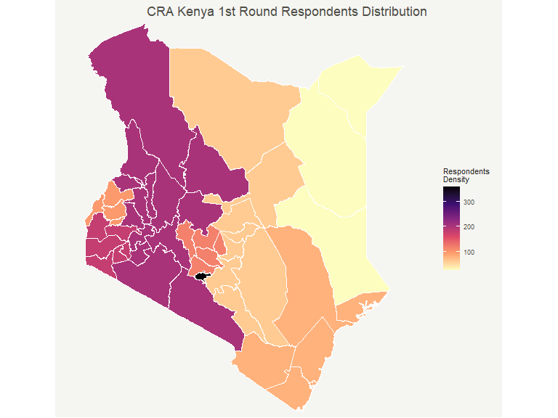
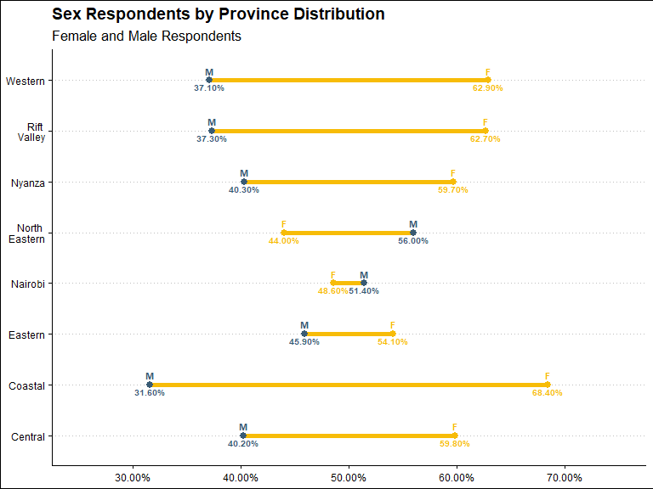
8. DEMOGRAPHICS
10 | Community Rapid Assessment on COVID: 3 Countries in ESAR
Notes:
- Across all countries we can see some distributions that will be controlled for on post stratification, including gender gap on respondents.
- However, we also can see that in comparison female and male distributions are constant when compared on rural and urban, pointing that gender gap appears also randomly, which can be solved through weighting.
- Similarly, the age trends points toward younger respondents which is expected given the relatively young population of the countries in East and Southern Africa.

Slide 11
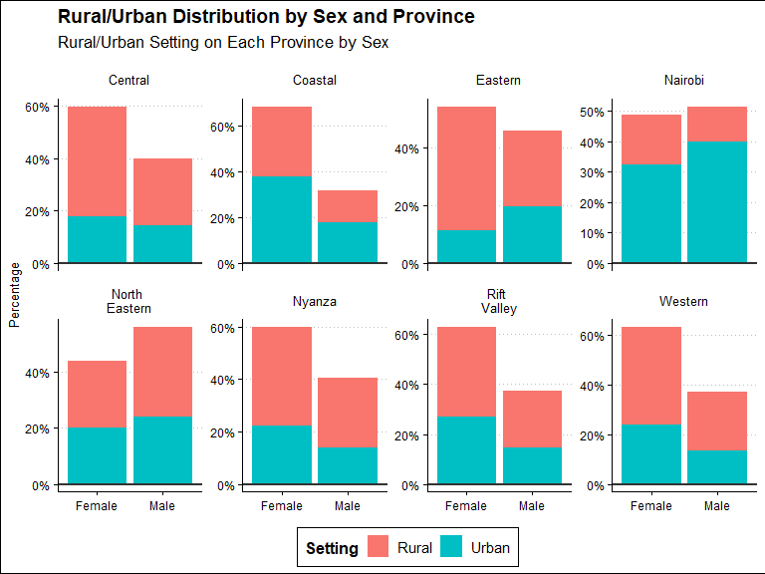
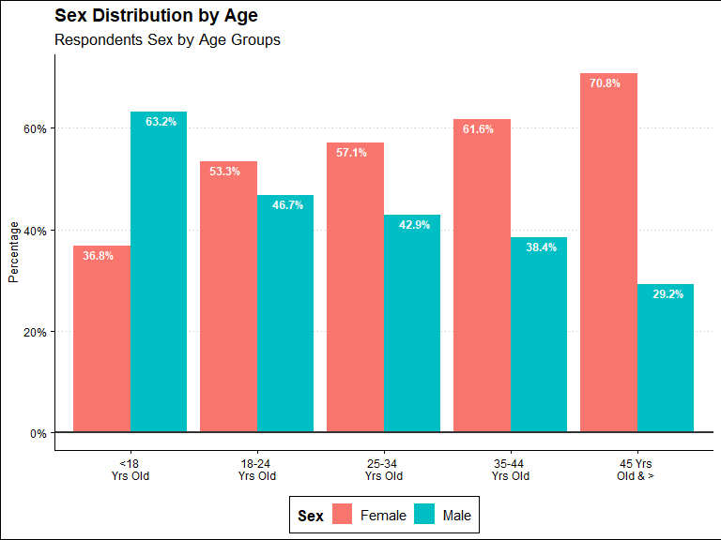
8. DEMOGRAPHICS
11 | Community Rapid Assessment on COVID: 3 Countries in ESAR
Notes:
- Across all countries we can see some distributions that will be controlled for on post stratification, including gender gap on respondents.
- However, we also can see that in comparison female and male distributions are constant when compared on rural and urban, pointing that gender gap appears also randomly, which can be solved through weighting.
- Similarly, the age trends points toward younger respondents which is expected given the relatively young population of the countries in East and Southern Africa.

Slide 12
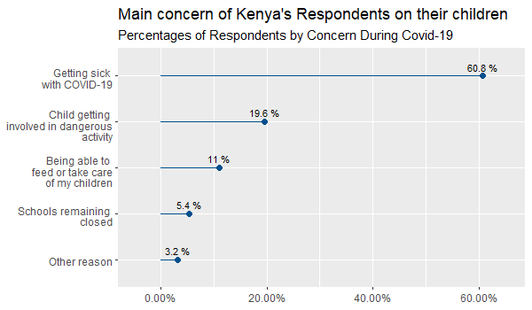
What are the main concerns and risk perception communities have during COVID-19?
12 | Community Rapid Assessment on COVID: 3 Countries in ESAR
Notes:
- Risk perception is high for majority of respondents across all countries. However, there is a visible segment that perceives to be at low risk of COVID-19.
- Looking at more detail at those that deem themselves as less risk can help target messaging and also identify if those groups correspond to vulnerable populations, for example those older than 60 years old, as has been the case in South Sudan.
- For Kenya, although risk perception was not directly asked, we can see that on the issues of most concern for families with Children, which is key for UNICEF, the biggest concern is falling sick with COVID-19. Also, specific issues regarding socio-economic impact are high on the respondent’s concerns.

Slide 13
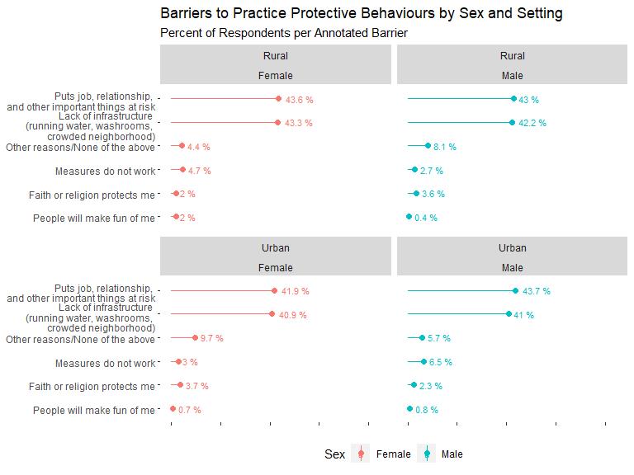
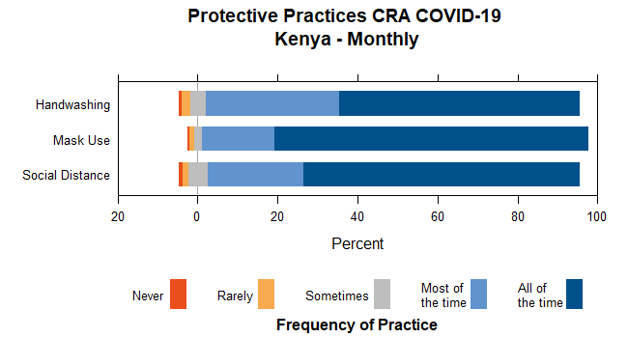
What are communities doing to protect themselves and what are the main barriers for practicing such protective behaviors against COVID-19?
13 | Community Rapid Assessment on COVID: 3 Countries in ESAR
Notes:
In Kenya, unlike S. Sudan and Madagascar, with the standard CRA questionnaire we are also able to look at more detail at barriers that can be identified to compliance, which highlights the point that compliance could likely be higher.
There seem to be some differences on reporting main barriers between profile of respondents particularly whether the measures work or now between urban and rural cohorts, and a higher percentages for social consequences and the role that religious ideas can play.
Although it seems those percentages are small those can be gateways to better identify the percentage of respondents who despite the high self-reporting of practice do report than do not perform the practice. It is on these groups, which are more likely at risk, where any incremental gain are likely to produce greater impact at reducing risk for these groups.
These are some of the areas where a further dive into hypothesis testing after weighting and correlation matrices can help us identify better profiles and areas where programming can be better tailored.

Slide 14
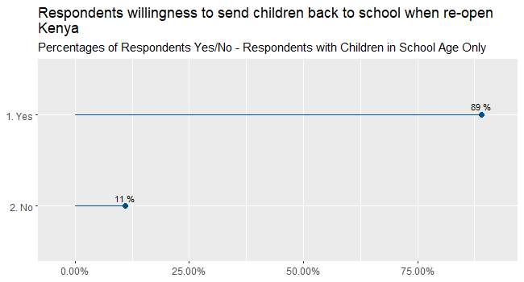
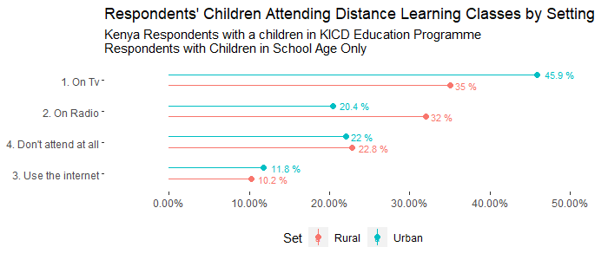
How are communities coping with school closures in rural vs urban settings?
14 | Community Rapid Assessment on COVID: 3 Countries in ESAR
Notes:
Madagascar does not have a question in their baseline on coping with school closures hence, it is not included. It will be included in subsequent rounds.
Main takeaways:
We can also see the impact of the pandemic on important areas and access to services, for example the impact on education. Here we can see how across two countries a general rate of access to distance learning is reported. There are some salient areas where more discussion is granted.
There seems to be major difference between the type of residents in South Sudan, where currently the refugee population reports to have more children attending distance learning. This is interest to contrast with the IDP population, and to possibly identify why vulnerable groups would have different rates.
For Kenya, the differences between Urban and Rural on medium TV and Radio seems to be very different between Urban and Rural and in both cases the overall high percentages also pinpoint the importance of education during the pandemic, to which there is a high level of support for sending children back to school when school reopens. This is one of the points that our colleagues later will expand on but can be key to look at support at a key area like education.

Slide 15
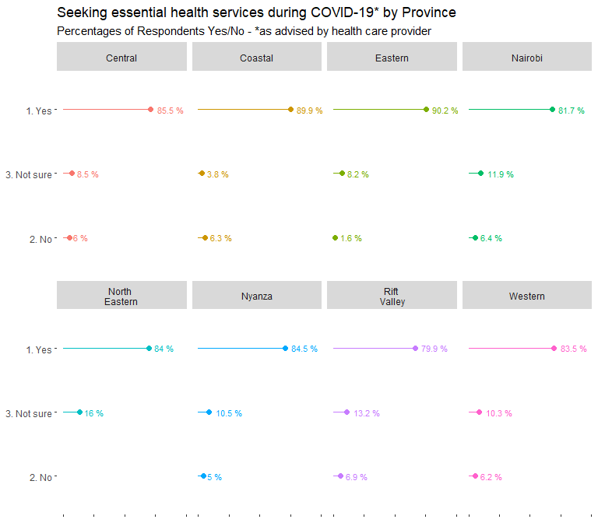
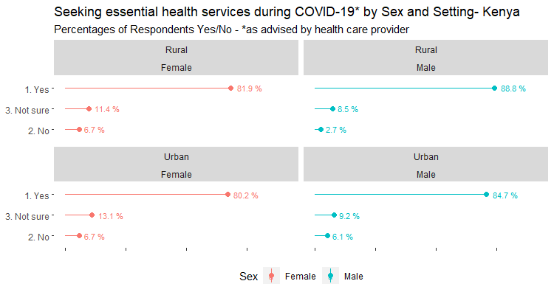
To what extent are communities accessing essential services during COVID-19?
15 | Community Rapid Assessment on COVID: 3 Countries in ESAR
Notes:
When we see another area for key services, Health care, we see that despite the pandemic a significant portion of the population are still attending health care services. This is important because it highlights how despite a perception of risk population still rely on an essential service like this.
This should be weighted and compared to previous levels of access to services to see if any significant change has taken place and if so whether or not this impacts particular groups. For example, it would be important to identify in Kenya, after a deeper dive on the data to better look at the profile of Urban Males as they seem to report less seeking health care services.

Slide 16
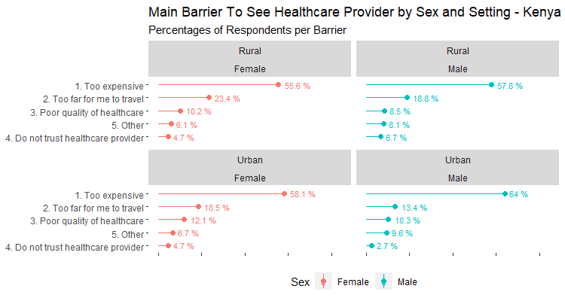
Which communities are not accessing key essential services during COVID-19?
16 Community Rapid Assessment on COVID: 3 Countries in ESAR
Notes:
When contrasting the previous with barriers to access health care we can identify issues like availability of key resources like soap and water at home, which is key for behaviors like handwashing. This also goes to what was previously reported on slide 12 where in South Sudan mask ownership is rather low.
This perception of risk combined with self-reported protective behaviors practice pinpoints that there are also issues of supply and demand around the material resources needed for the behaviors and the demand that is shown for the importance of the practice and the intent, where the resources available to increase compliance and match both sides of the practices.

Slide 17
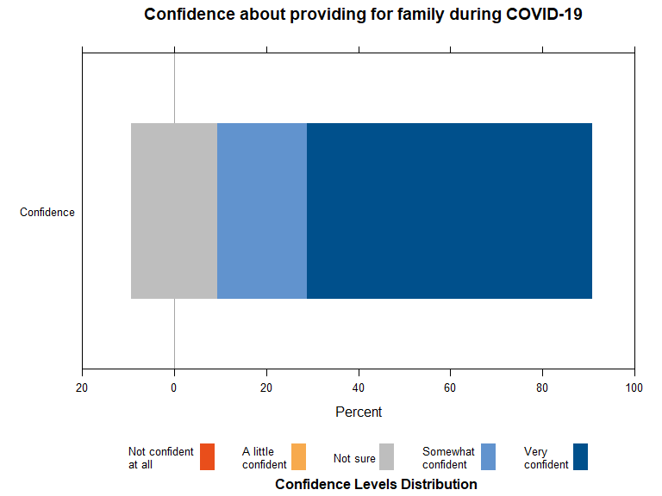
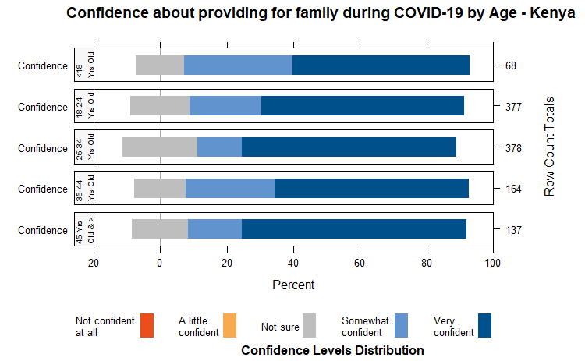
How confident do communities feel about managing COVID-19?
17 | Community Rapid Assessment on COVID: 3 Countries in ESAR
Notes:
Furthermore, when seeing the impact at the community level, we can start identifying some areas where respondents are reporting changes. For example, respondents in Madagascar have identified rather large percentages of changes on food consumption and basic needs products.
More worrisome if the reported reduction of vaccinations and breastfeeding, where if contrasted with other information, can likely point to very sensitive areas where even such smaller percentages can have a great impact for populations at risk and the development of children.
We can also see that this seems to impact the overall confidence of the respondents to provide for their families. Although there are large levels of confidence, the levels of uncertainty see to change for key age groups in Kenya, where groups between 25-34 years old have greater number of respondents unsure. A later test of correlation of this groups and access to services and whether they have children or not, is likely to shed light on possible impacts for such groups.

Slide 18
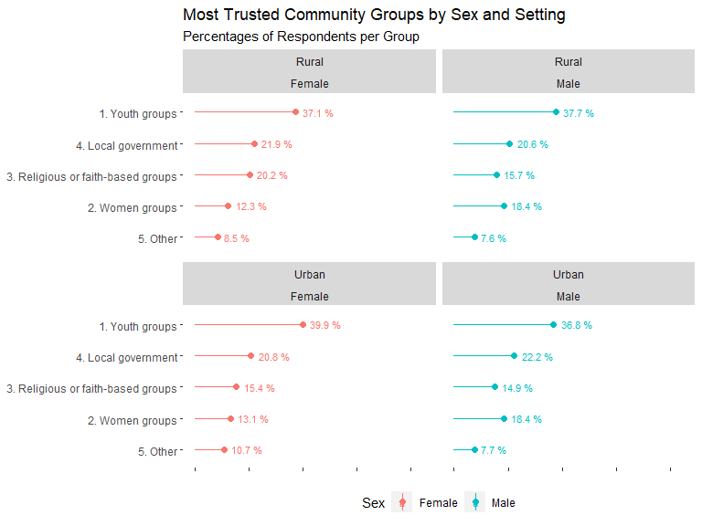
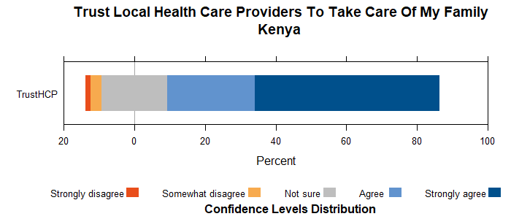
To what extent do communities trust their local health care providers and community groups?
18 | Community Rapid Assessment on COVID: 3 Countries in ESAR
Notes:
Overall, trust play a key factor. For example, for the three countries included, although with different scales that are still narratively relatable and comparable, we can see that trust and confidence on health care providers is high for the most part.
However, in comparison with all other Likert scales on self report confidence the trust levels for lack of confidence and uncertainty are higher. This grants a further look when we will look into hypothesis testing as trust is one key factor as operationalized in the Behavioral Drivers Model when looking at how behaviors overall take place.

Slide 19
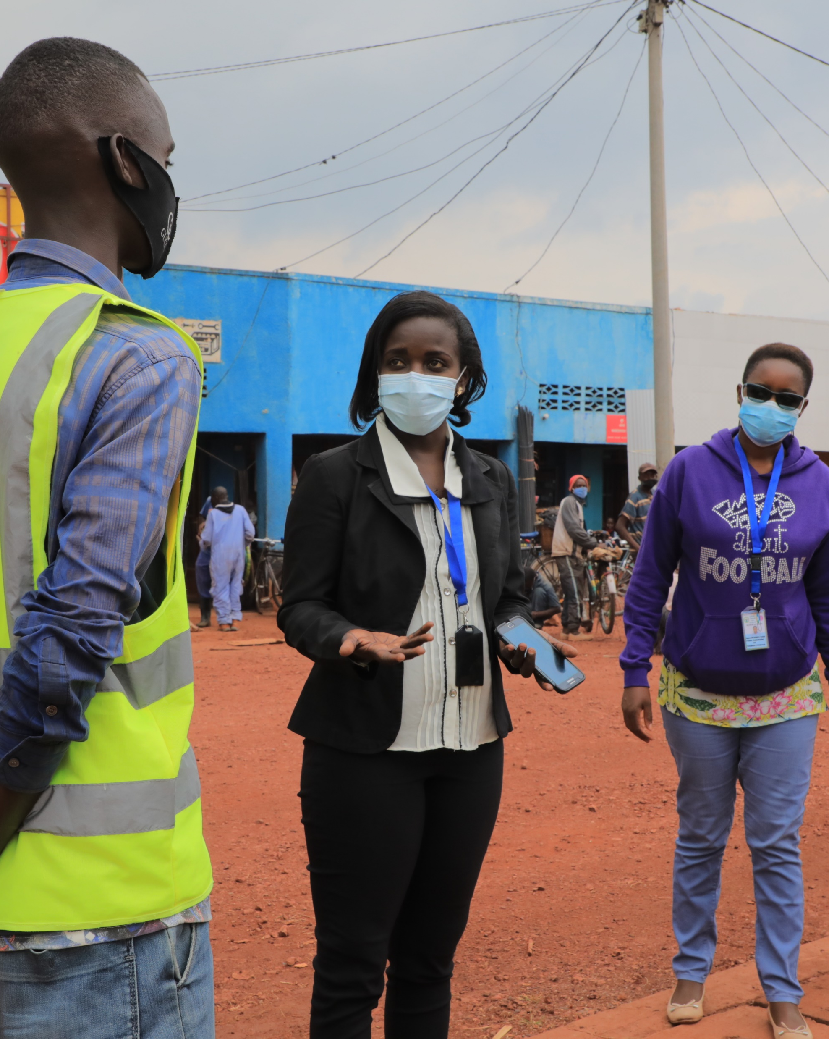
9. Findings: How can rapid community-sourced data provide reliable and quick evidence-driven insights to inform UNICEF programming?
Program Implications
© UNICEF/PHOTO CREDIT
21 | Community Rapid Assessment on COVID: 3 Countries in ESAR

Slide 20
KENYA: Key Takeaways
For indicators related to practice of protective behaviors, no significant difference between sex, age and geographical location
Interesting to note that the main barriers to practice protective behaviors were:
Puts jobs, relationships and other important things at risk
Lack of infrastructure (lack running water, washrooms, crowded neighborhood)
Trusted community groups were identified as youth groups and women's groups, while religious leaders scored very low
22 | Community Rapid Assessment on COVID: 3 Countries in ESAR

Slide 21
KENYA: Program Implications, Use and Uptake
1. How have you used, or will you use insights generated by this first round of data collection to improve current CO responses to COVID-19? What is missing?
Data is being used for advocacy purposes
Parents willingness to send kids back to school (89%) used to advocate for early school reopening
To support communication messaging
To support choice of influencer groups (youth and women’s groups)
21 | Community Rapid Assessment on COVID: 3 Countries in ESAR

Slide 22
KENYA: Program Implications, Use and Uptake
2. What are some of the lessons learned about the method and questionnaire used during this first round of data collection?
• Need to reduce introduction of bias for some questions (self-reporting vs. third person)
"Do you always wear a mask" vs "Do people in your community always wear a mask?"
• Need to change the order of responses (not having the most acceptable answer as the 1st response in the list of responses)
22 | Community Rapid Assessment on COVID: 3 Countries in ESAR

Slide 23
KENYA: Program Implications, Use and Uptake
3. What are the most critical population data needs for UNICEF C4D and governments to act on at this stage in the pandemic? What are the critical behaviors that will need to be observed during the pandemic?
Critical population data:
• It would be interesting to dwell more on the youth population (75% of Kenya’s population is below 35 years)
• Urban high-density informal settlements
Key behaviors:
• Wearing a mask
• Handwashing
• Social distancing
• Testing
23 | Community Rapid Assessment on COVID: 3 Countries in ESAR

Slide 24
11. Strengths and Limitations
Strengths:
Quick adaptation of survey to country needs especially in emergencies. Phones allow for quick and flexible changes in questions.
Reduced costs and time when compared to other alternatives (vs. Paper Based)
Standardization facilitates analysis and design
Sources data directly from individuals rather than head of households
Richness of cross-tabular analysis with available demographic variables (Hypothesis testing needed)
Temporal element provides richer narrative of evolving situation.
BDM strong adaptability across sectors
Short surveys in time series allows for quicker results iteration of interventions or strategies.
Limitations:
Survey length using phones limits extent of investigation.
Variable airtime costs and phone penetration rates may skew representativeness of population.
Limited aggregation and comparability at regional level due to heterogeneity of surveys
Absence of comparable studies
Generalized difficulty to integrate different surveys to contrast results
Observational effect on self-reporting questions on ‘practices’ (Desirability Bias)
Demand for adequate analytical capacity across the organization if such high frequency systems are in place.
24 | Community Rapid Assessment on COVID: 3 Countries in ESAR

Slide 25

Thank you.
Questions, suggestions, and ideas are welcome.
© UNICEF/UN0216133

Slide 26
References
Petit, V. (2019). The Behavioural Drivers Model: A Conceptual Framework for Social and Behaviour Change Programming. UNICEF.
Croke, Kevin, et al. “Collecting High Frequency Panel Data in Africa Using Mobile Phone Interviews.” Policy Research Working Papers, 2012, doi:10.1596/1813-9450-6097
Deborah Toppenberg-Pejcic, Jane Noyes, Tomas Allen, Nyka Alexander, Marsha Vanderford & Gaya Gamhewage (2019) Emergency Risk Communication: Lessons Learned from a Rapid Review of Recent Gray Literature on Ebola, Zika, and Yellow Fever, Health Communication, 34:4, 437-455, DOI: 10.1080/10410236.2017.1405488
Durbin, Will, et al. “Chapter 3:Using Mobile Phones for High-Frequency Data Collection.” Mobile Research Methods: Opportunities and Challenges of Mobile Research Methodologies, by Daniele Toninelli et al., Ubiquity Press, 2015
Gamma, Anna E., et al. “The Impact of Various Promotional Activities on Ebola Prevention Behaviors and Psychosocial Factors Predicting Ebola Prevention Behaviors in the Gambia Evaluation of Ebola Prevention Promotions.” International Journal of Environmental Research and Public Health, vol. 16, no. 11, 2019, p. 2020., doi:10.3390/ijerph16112020
Giroux, Stacey A., et al. “A High-Frequency Mobile Phone Data Collection Approach for Research in Social-Environmental Systems: Applications in Climate Variability and Food Security in Sub-Saharan Africa.” Environmental Modelling & Software, vol. 119, 2019, pp. 57–69., doi:10.1016/j.envsoft.2019.05.011
26 | Community Rapid Assessment on COVID: 3 Countries in ESAR

Slide 27
References (continued)​
Grantz, K.H., Meredith, H.R., Cummings, D.A.T. et al. The use of mobile phone data to inform analysis of COVID-19 pandemic epidemiology. Nat Commun 11, 4961 (2020). https://doi.org/10.1038/s41467-020-18190-5
Jacobsen, Kathryn H., et al. “Lessons from the Ebola Outbreak: Action Items for Emerging Infectious Disease Preparedness and Response.” EcoHealth, vol. 13, no. 1, 2016, pp. 200–212., doi:10.1007/s10393-016-1100-5
Li, Jingtao, et al. “Behaviors of High-Frequency Subscribers in Cellular Data Networks.” Security and Communication Networks, vol. 2018, 2018, pp. 1–12., doi:10.1155/2018/2506319 ​
Milusheva, Sveta. “Using Mobile Phone Data to Reduce Spread of Disease.” Policy Research Working Papers, 2020, doi:10.1596/1813-9450-9198. ​
Oliver, Nuria, et al. “Mobile Phone Data for Informing Public Health Actions across the COVID-19 Pandemic Life Cycle.” Science Advances, vol. 6, no. 23, 2020, doi:10.1126/sciadv.abc0764​
Winters, Maike, et al. “Risk Communication and Ebola-Specific Knowledge and Behavior during 2014–2015 Outbreak, Sierra Leone.” Emerging Infectious Diseases, vol. 24, no. 2, 2018, pp. 336–344., doi:10.3201/eid2402.171028
Zhang, Liwei, et al. “Effective Risk Communication for Public Health Emergency: Reflection on the COVID-19 (2019-NCoV) Outbreak in Wuhan, China.” Healthcare, vol. 8, no. 1, 2020, p. 64., doi:10.3390/healthcare8010064
27 | Community Rapid Assessment on COVID: 3 Countries in ESAR

